Slide 2
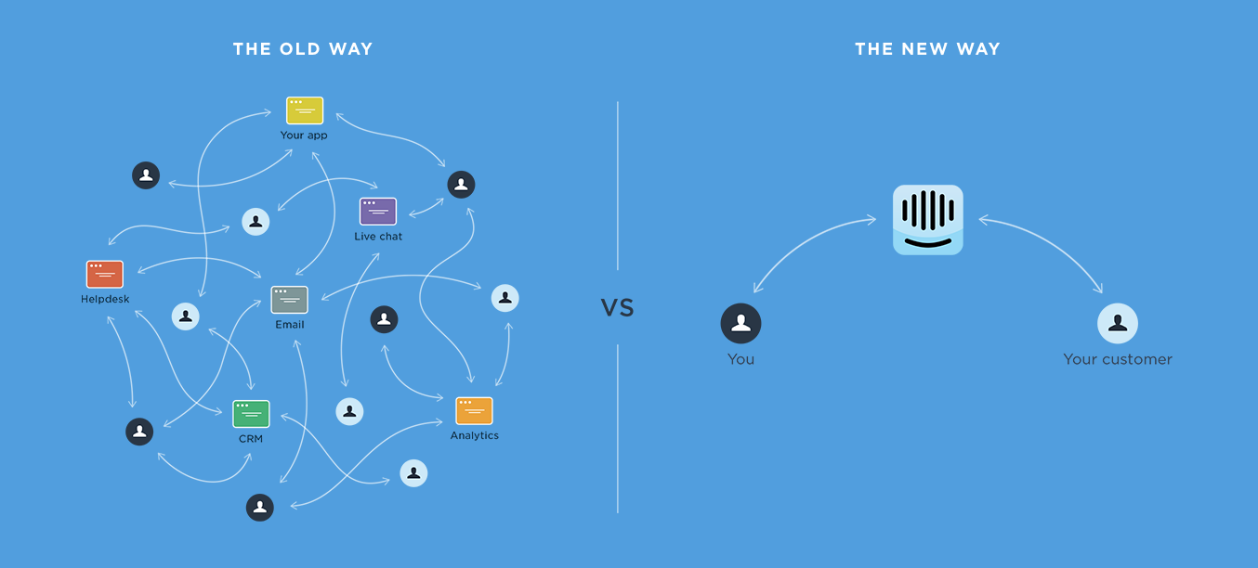

Slide 3
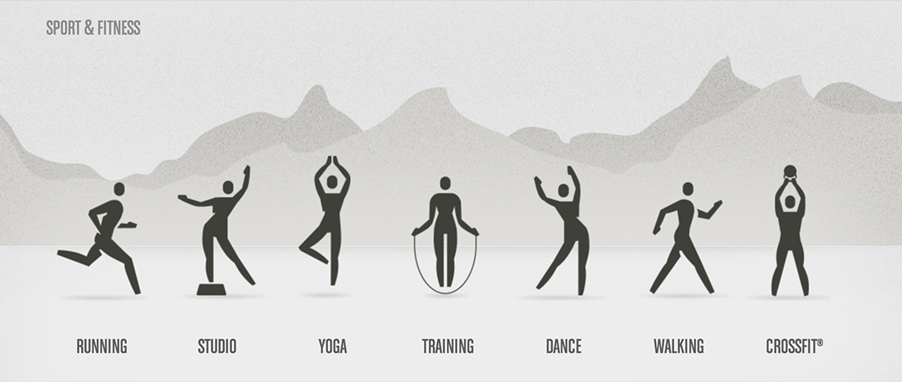
Human figures are used to represent sport categories.
http://zurb.com/triggers/visual-metaphor/process-from-quirky

